Slide 1

GYM MASTER
System
--------------------------------------------------------------------------------------
By team-08

Slide 2

Team Members:-
Piyush Kumar(20cse038)
Neeraj Kumar(20cse054)
Priya Khetan(20cse052)
Suraj Prasad(20cse032)
Arman Arya(20cse116)
V. Shalini(20cse303)
Prasanna Kumar(20cse296)
Prashant Panda(20cst010)

Slide 3
What is GMS?
Our Gym Master System is an online site which keeps records of your members, their memberships and have quick and easy communication between you and your members. This proposed system also provides the total information about machinery data and number of coaches also stored. Services provided by Gym are also handled by this system including its timing. The user shall be able to add the name, date of birth and contact address of the member.

Slide 4

Objectives
The existing System such as Gym Master is not as much as user (Customer) friendly as compare to our Proposed System.
The communication with members is not well in Existing System because all the data is handled by Gym manager.
Customers can do easily complain and yes, hiring process of customer will also get easier.
Complete payment statistics with downloadable content to excel in csv file format.
If any machine is not working properly then you can easily give notice by using this site.

Slide 5
Gym Master System Specifications
Member: This module shall have all the details pertaining to the member such as name, contact number, gender, address, date of birth, admission date etc.
Fee Payment: This module includes the fee payments. It has the type of payments, amount paid etc.
Reports: This module includes the report data. It notifies about the pending fee payment for different members. And also prints reports of fee payments.
Notification: By using this site, customer can easily me notified by any notice like tomorrow gym will be closed or this machine will not work, etc.
Choice- You will able to choose your trainer, by watching this website.

Slide 6





Used Elements
Hardware used:
Monitor
Ryzen-7 Quad-core processor
RGB keyboard and mouse
Software used:
Operating System: Windows 11
Developer Tool- VS code
Languages- HTML, CSS & Javascript

Slide 7

Well..!!, This is the home page of our site. As you can see here, there are some buttons at the top which will directly get you to that page where you want.

Slide 8
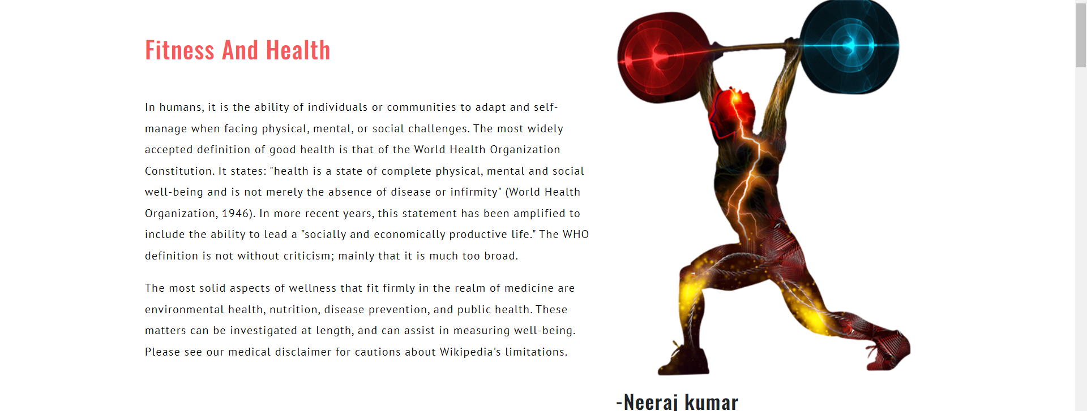
This is blog area or you can say the comment section of our gym, here the happy customer of our firm can write, comment their thought and you can give your reviews here by writing comment.

Slide 9
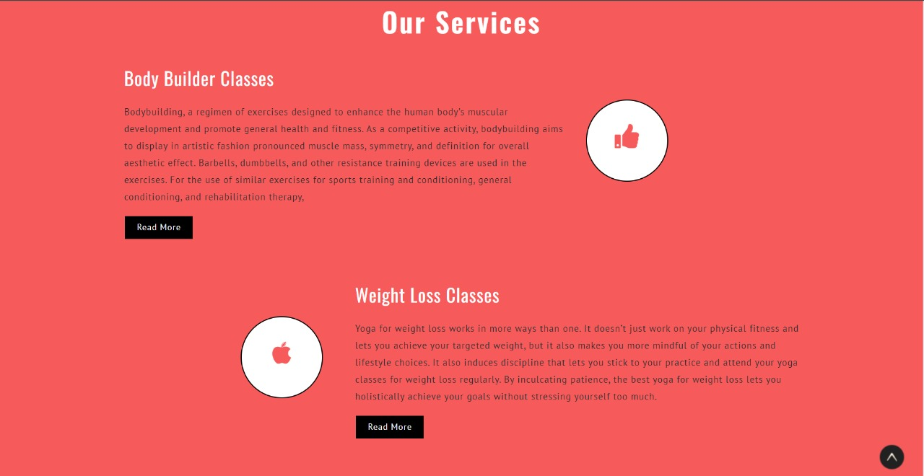
These are the services provided by our gym and people can check out with here.

Slide 10

This is the customer section of our project where other public can see that how we are working with our clients and also are they happy with our services or not.

Slide 11
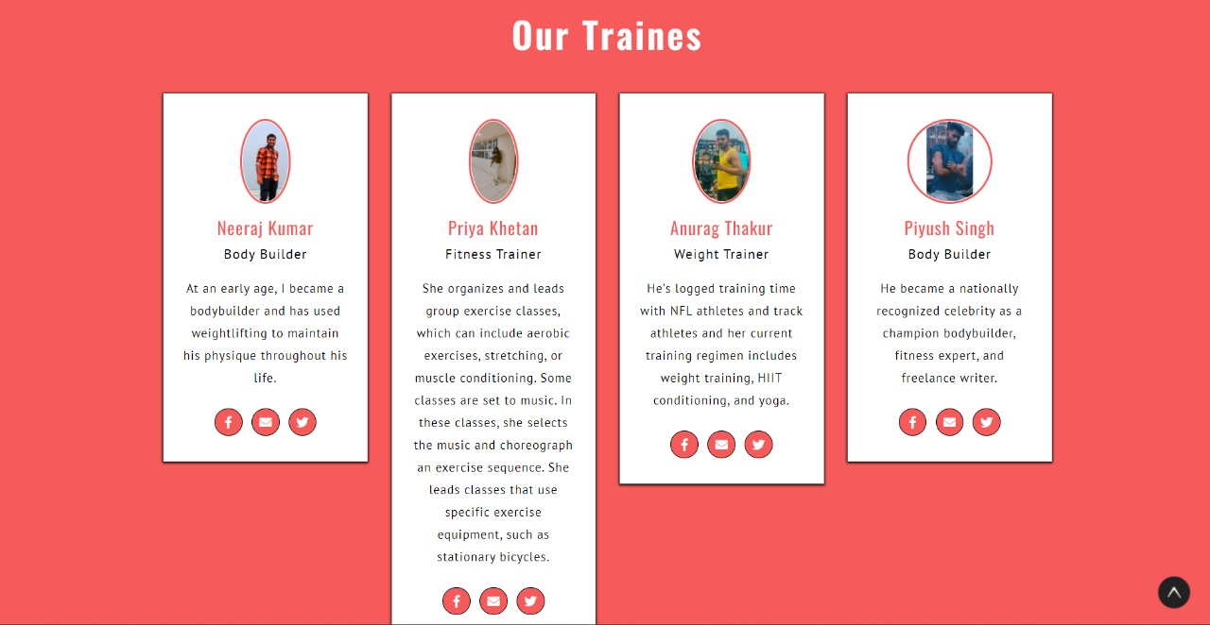
As I told you, here is the feature to select you trainer by yourself only. So, this is the list. You can easily choose your trainer from here and also you will able to know the achievements of trainer and category.

Slide 12

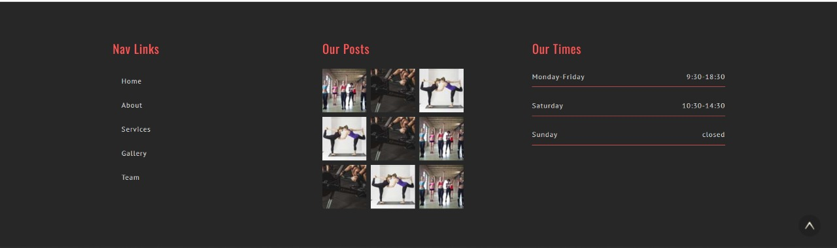
And lastly, this is the contact page of our site, here can see some numbers of our staffs are present and also go to top button.

Slide 13

Great experience to work with you sir👍
Thank You.

